Slide 1
QMST 5335 – FORECASTING AND SIMULATION Project 3 Description by Dincer Konur
Department of Computer Information Systems and Quantitative Methods McCoy College of Business Administration Texas State University

Slide 2
Outline
Bank System Explanation
Scenarios and Data
Project Requirements

Slide 3
Outline
Bank System Explanation
Scenarios and Data
Project Requirements

Slide 4
Bank System Explanation
Bank System
Customers arrive → Sign-in → Get Help
Three types of customers
Basic need customers:
They are directed to either an ATM (most likely) or a Teller by the SignIn employee
Moderate need customers:
They can be directed to an ATM or a Teller (most likely) or a Manager
Advanced need customers:
They can be directed to a Teller or a Manager (most likely)
SignIn is where one bank employee helps a customer how to navigate in the bank
After SignIn, a customer is told to go to either ATM line, Teller Line, or Manager Line
SignIn time depends on the customer type

Slide 5
Bank System Explanation
Bank System
Three types of service providers
ATM area:
A single queue feeds to ATM service area
An ATM execution time is independent of the customer type
Currently there are 3 ATMs in the ATM service area
Tellers:
A single queue feeds to the Tellers
A Teller execution time is independent of the customer type
Currently there are 4 tellers
Managers:
A single queue feeds to the Managers
A Manager execution time is independent of the customer type
Currently there are 2 managers
All queue disciplines are first-come-first-served

Slide 6
Outline
Bank System Explanation
Scenarios and Data
Project Requirements

Slide 7
Scenarios
The bank is planning to hire two additional employees and want to use simulation to decide for which positions these two additional employees should be hired?
There are the following 4 hiring scenarios
Scenario A : 2 sign-in employees, 0 teller, 0 manager
Scenario B : 0 sign-in employee, 2 tellers, 0 manager
Scenario C : 0 sign-in employee, 0 teller, 2 managers
Scenario D : 1 sign-in employee, 1 teller, 0 manager
Scenario E : 1 sign-in employee, 0 teller, 1 manager
Scenario F : 0 sign-in employee, 1 teller, 1 manager
Comparison is based on the following:
How much time a customer spends in the bank (from entrance until leaving) on average?
How many customers are present inside the bank on average?
How much time customers directed to each service option (ATM, Teller, Manager) spend in the corresponding queue on average?

Slide 8
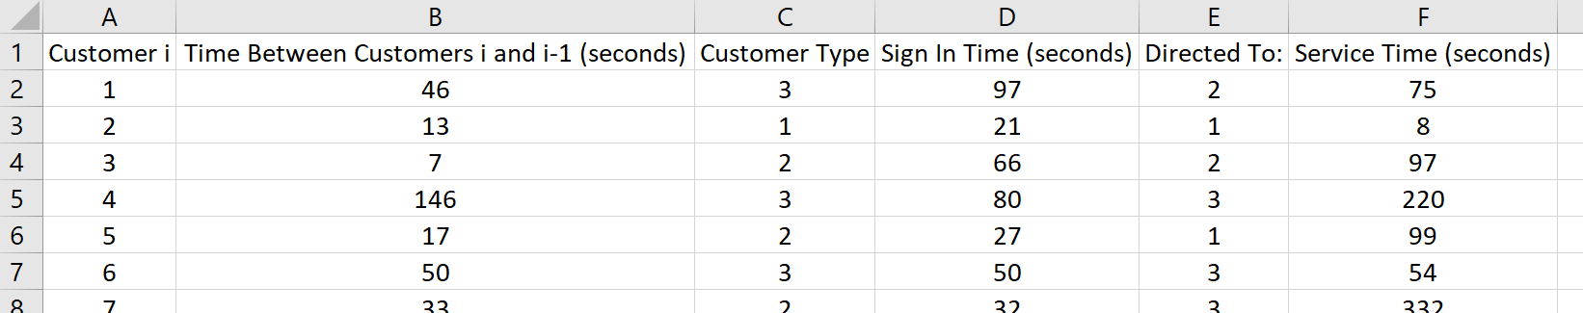
Data
What data are available?
Data for 500 customers arrivals: Customer number, 1 to 500, in column A (customer i)
Times between customer i and i-1 (seconds) in column B
Customer type (column C): 1 for basic needs, 2 for moderate needs, 3 for advanced needs
SignIn time for each customer (seconds) in column D
Directed to on column E:
1 if customer is directed to ATMs,
2 if customer is directed to Tellers, and
3 if customer is directed to Managers
Service time for each customer (either at ATM, Teller, or Manager) in column F

Slide 9
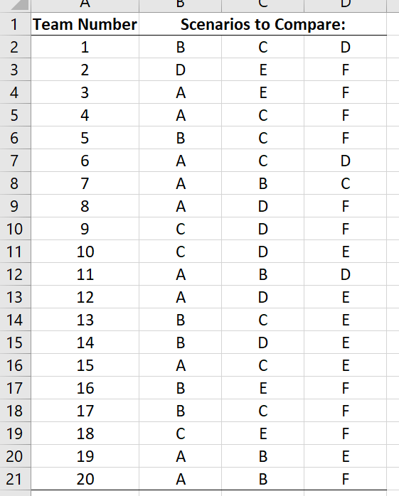
Scenarios and Data for Teams
Each team will compare three of the six scenarios
See Project 3 - Assignments.xlsx file for your team’s three scenarios
For instance, Team 20 will compare Scenarios A, B, F and the current status
So, each team will compare three scenarios against the current status and against each other
Each team will have its own customer data
See Project 3 – Data.xlsx.
A team’s data is in the sheet with sheet number as the team number
For instance, Team 20 should use data in Sheet 20 of Project 3 – Data.xlsx
If you use wrong data, you will not get any credit from Part 1 of the project.
Each data sheet has different data values for various things

Slide 10
Outline
Bank System Explanation
Scenarios and Data
Project Requirements

Slide 11
Project Requirements
Part 1 – Explain the system, give a visualization (flow chart)
Part 2 – Data Analysis
Using the data file, determine the interarrival time distribution
There will be one distribution defining how customers arrive
Using the data file, estimate the % of customers being type 1, 2, or 3
These will be just 3 percentages/probabilities, summing to 100% or 1 (use 1% increments)
For instance, a possible result is 12% of customers is type 1, 33% of customers is type 2, 55% of customers is type 3
Using the data file, determine the best distributions for SignIn time for each customer type
Here, you will generate three fitted distributions for the SignIn times, i.e., SignIn time distribution for type 1 customers, SignIn time distribution for type 2 customers, and SignIn time distribution for type 3 customers
Using the data file, determine the % of each customer type being directed to each service option
These will be 9 percentages/probabilities, 3 for each customer type (use 1% increments)
For instance, a possible result (numbers are just made up) is:
30%, 70%, and 0% of type 1 customers is directed to ATMs, Tellers, and Managers, respectively
35%, 45%, and 20% of type 2 customers is directed to ATMs, Tellers, and Managers, respectively
40%, 15%, and 45% of type 3 customers is directed to ATMs, Tellers, and Managers, respectively
Using the data file, determine the best distributions for service time at each service option
Here, you will generate three fitted distributions for the service times, i.e., ATM time (time any customer spends in ATM) distribution, Teller time (time any customer spends with a Teller) distribution, and Manager time (time any customer spends with a Manager) distribution

Slide 12
Project Requirements
Part 3 – Simio Model and Verification
Create a Simio model for the system
Verify the model comparing it with Jackson Network (assuming the means of the distributions are the means of the exponential distribution)
Just show the results, no need for separate simio file for verification
So, before setting up the scenarios/experiments, you can do the verification
Run the model with the current system and observe the problems
Develop experiments
Determine the warmup, run length, and use 100 replications for each different scenario
In the same model, setup an experiment to test the four scenarios (current system plus three alternatives) and compare them based on the comparison statistics discussed
The experiment results should be able to produce the SMORE plots (so make sure to add responses for the comparison statistics)
Part 4 – Discussion
Based on the results of the experimentation, discuss which option is better in terms of which statistic
Based on the discussion of the results, make a recommendation
Need to submit:
PPT for the presentation; submit it before presentation
Simio file → ready for the presentation, need to submit the final version by the deadline
Report pdf → can submit after presentation, need to submit the final version by the deadline

Slide 13
Project Requirements
Presentation ~15 minutes (10 points)
Content (7 points based on the topics below): Suggestions
System Explanation ~1 minutes and Data Analyses results ~2-3 mins
Simio Model ~3-4minutes (explain the design and verification, how you use tables/reference properties, what are the problems observed in the current system based on initial run)
Simio Experiment Setup ~ 1-2 minutes (explain the scenarios, replications, lengths, etc.)
Demonstrate the comparison results ~3-4 minutes (SMOREs, highlight the differences of the statistics)
Recommendations ~1-2 minutes
If applicable, questions and answers
Format and Presentation (3 points based on the topics below)
Use of slides, figures, texts, sectioning, outline…
Some hints: http://www.garrreynolds.com/preso-tips/design/ https://cft.vanderbilt.edu/guides-sub-pages/making-better-powerpoint-presentations/ https://www.ncsl.org/legislators-staff/legislative-staff/legislative-staff-coordinating-committee/tips-for-making-effective-powerpoint-presentations.aspx
Flow of presentation, clearness, highlighting important points, not missing important points
Timing

Slide 14
Project Requirements
Simio file (4 points)
Should have the system model in the facility view
Meaningful names to the objects, tables, responses, reference properties
Different customer types → different symbol colors (or animations)
Correct information → correct rates, and distributions
Table → correct data put into the table, correctly referring to the table
Should have the experiment and scenarios ready to run
Correct scenarios for the alternatives compared
Correct responses

Slide 15
Project Requirements
Report (10 points):
Format (1 point): 20 pages max (excluding cover page, appendix) 1.5spacing, 11pt Times New Roman, 1inch margins
Cover page (team #, member names), sectioning, typos/grammar
Appendix might have detailed SMORE plots, Tables, figures
First section (2 points):
Explain the system, give the flow chart (subsection)
Give the results of Data analyses (subsection, detailed results in the appendix)
Explain the Simio model overview, give the picture (subsection)
Give the verification results (using Jackson network)
Criticize the current system based on initial run and introduce the alternatives you are going to test, and discuss how are they expected to help (subsection)
Second section (5 points):
Explain the details of experimentation, scenarios
Give the results of the scenarios, discuss the results (this alternative decreased that value, increased that value.. Etc), put the SMORE plots, discuss the experiment results in detail, give tables as needed
Last section (2 points):
Make recommendations
Discuss if the results were expected
See Project 3 – Report Format and Guidelines

Slide 16
Submission
Four items to submit
Simio file, spfx format, ready for run with all the experiments
Report, pdf format, not other formats will be graded
Powerpoint slides, ppt or pdf format
Presentation:
Either link for a pre-recorded video, or presentation on the ppt
Or, present live by scheduling a date and time with the instructor before May 8th, 5pm.
Everything should be completed and submitted by May 11, Monday, by 5pm (cst)

